Slide 1

C# Basics
YouTube.com/ProgrammingMadeEZ
Techie-Tid-Bits.Blogspot.com
15+ years in Technology Industry
MS SQL Server DBA
Full Stack .NET Developer
(emphasis on ASP.NET MVC)
Sr. Software Architect
Gartman Technical Services
Hosted By: Steve Bishop

Slide 2
Introduction
What is this series about?
Learning the basics of the C# Language and a little bit about .NET, Visual Studio, and Object Oriented Programming
What is this series NOT about?
This is an introduction to some basic concepts only. You will not be learning how to make a complete application from start to finish.
Why should you watch this series?
You should watch this series if you are interested in understanding the basic concepts of the C# Language. That way you can be prepared for the intermediate and advance courses to follow.
What do I need?
You will need access to a PC that you are permitted to install software onto, and lots of time.

Slide 3
Introduction
7 Sections
Introduction
Installing and Using Visual Studio
Basic Concepts
Control Flow
Classes
Object Oriented Programming
Odds & Ends

Slide 4
C# Basics
YouTube.com/ProgrammingMadeEZ
Techie-Tid-Bits.Blogspot.com
Hosted By: Steve Bishop

Slide 5
Installing and Using Visual Studio Summary
Downloading And Installing
Creating a Solution and Project
Windows and Navigation
Solution and Project Properties

Slide 6
Downloading And Installing Visual Studio 2015
Navigate to https://www.visualstudio.com/
Download Community Edition
Run Installer
Open Visual Studio

Slide 7
End Of Presentation

Slide 8
C# Basics
YouTube.com/ProgrammingMadeEZ
Techie-Tid-Bits.Blogspot.com
Hosted By: Steve Bishop

Slide 9
Creating a Solution and Project
Different Ways To Create A Project
Start Page
File Menu
Select the Project Template
Name the Project
Location of Project

Slide 10
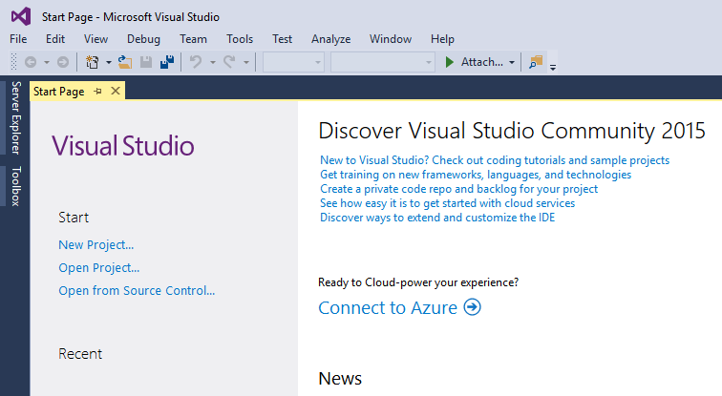

Slide 11
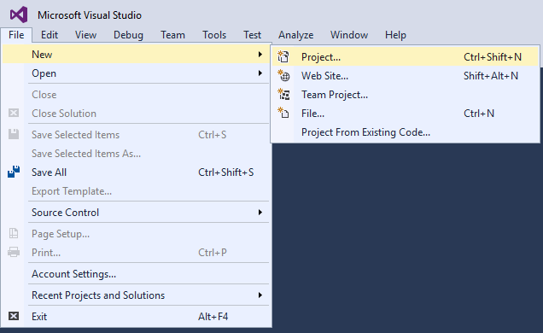

Slide 12
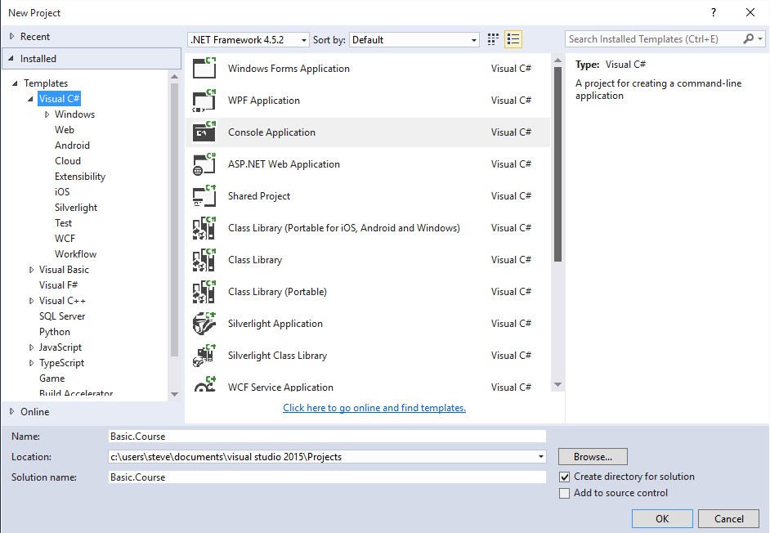

Slide 13
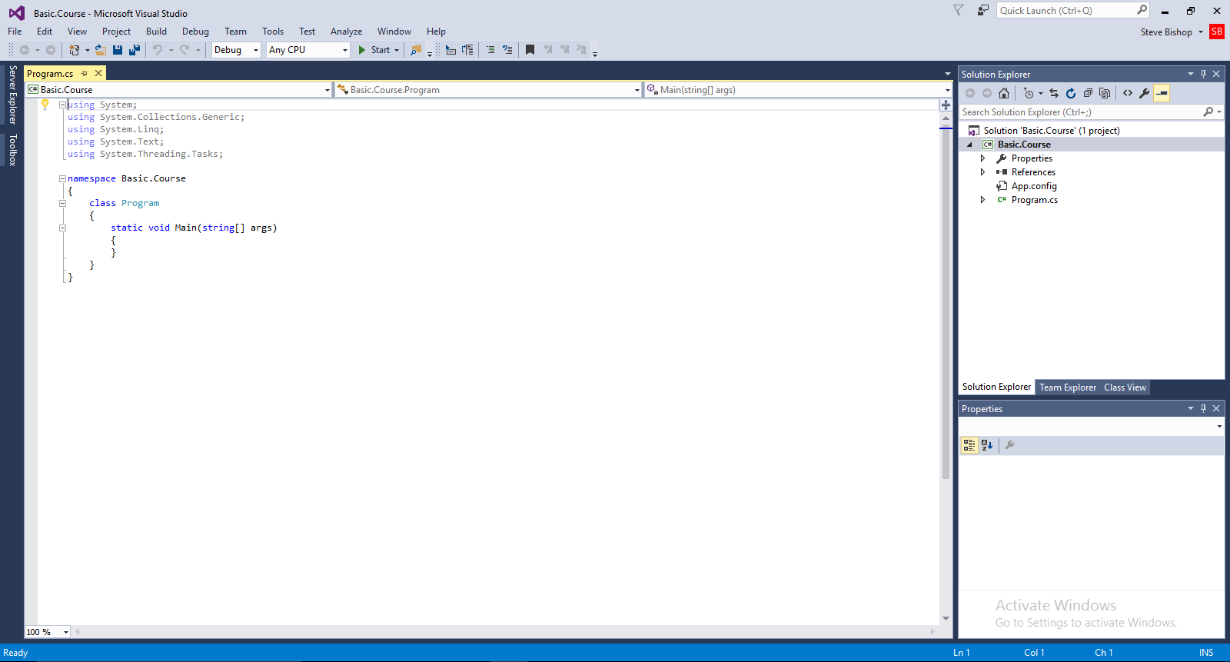

Slide 14
End Of Presentation

Slide 15
C# Basics
YouTube.com/ProgrammingMadeEZ
Techie-Tid-Bits.Blogspot.com
Hosted By: Steve Bishop

Slide 16
Creating a Solution and Project
Demo

Slide 17
C# Basics
YouTube.com/ProgrammingMadeEZ
Techie-Tid-Bits.Blogspot.com
Hosted By: Steve Bishop

Slide 18
Visual Studio Windows and navigation
Code Window
Drop Downs for Navigating the Code
Output Window
Solution Explorer
Solution
Project
Properties
References
App.config
Program.cs
Properties Window

Slide 19
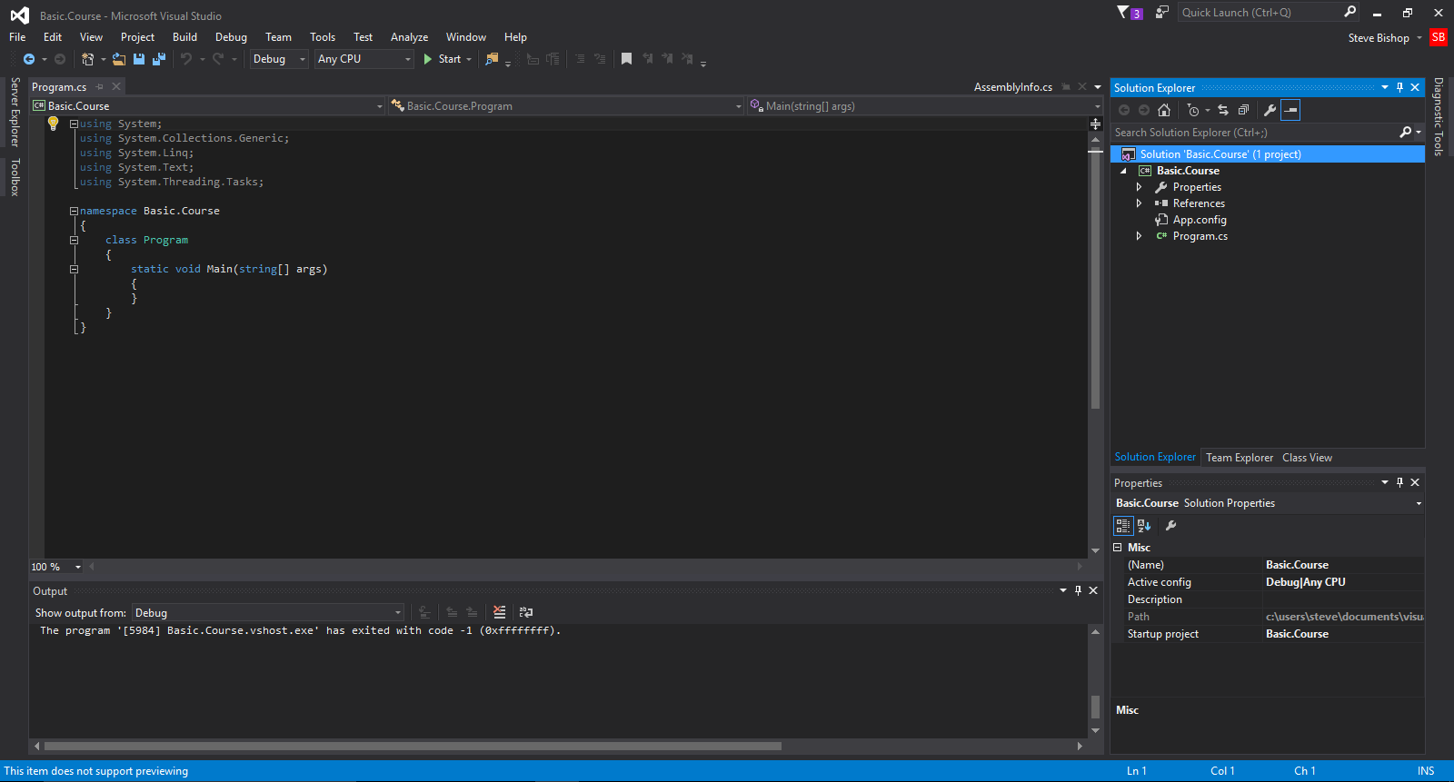
Solution Explorer
Code Window
Output Window
Properties Window

Slide 20
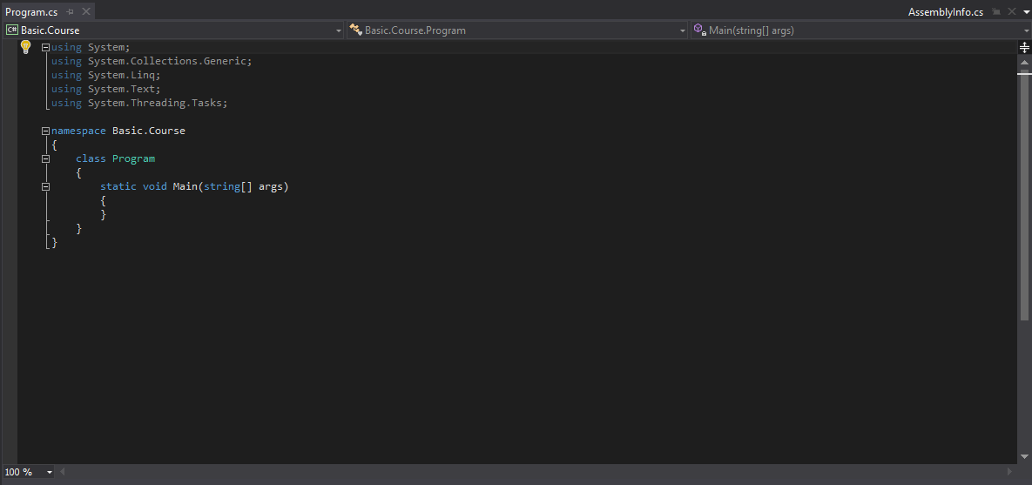
Code Window

Slide 21
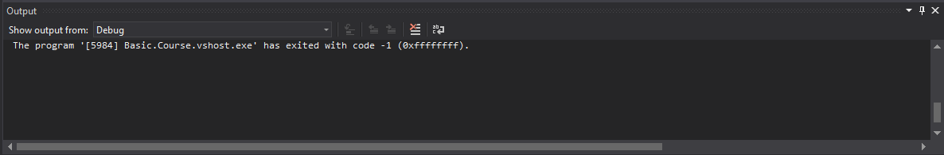
Output Window

Slide 22
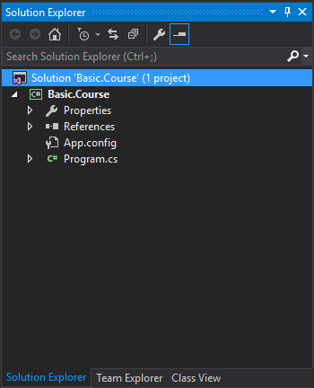
Solution Explorer
Solution
Project

Slide 23
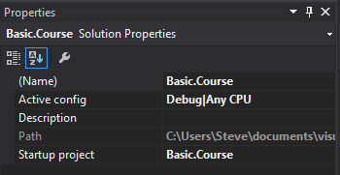
Properties Window

Slide 24
End Of Presentation

Slide 25
C# Basics
YouTube.com/ProgrammingMadeEZ
Techie-Tid-Bits.Blogspot.com
Hosted By: Steve Bishop

Slide 26
Visual Studio Windows and navigation
Demo

Slide 27
C# Basics
YouTube.com/ProgrammingMadeEZ
Techie-Tid-Bits.Blogspot.com
Hosted By: Steve Bishop

Slide 28
Solution and Project Properties
Opening the Solution Properties Page
Setting The Startup Projects
Opening the Project Properties Page
Application Section
Assembly Name & Default Namespace
Target Framework
Output Type
Startup Object
Build Section
Platform Target

Slide 29
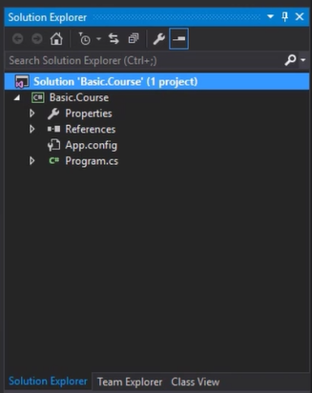
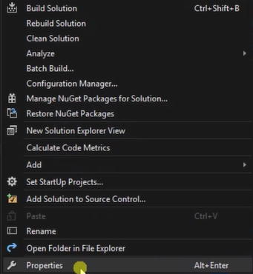
Opening The Solution Properties Page

Slide 30
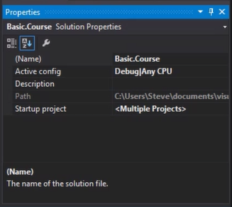
Opening The Solution Properties Page

Slide 31
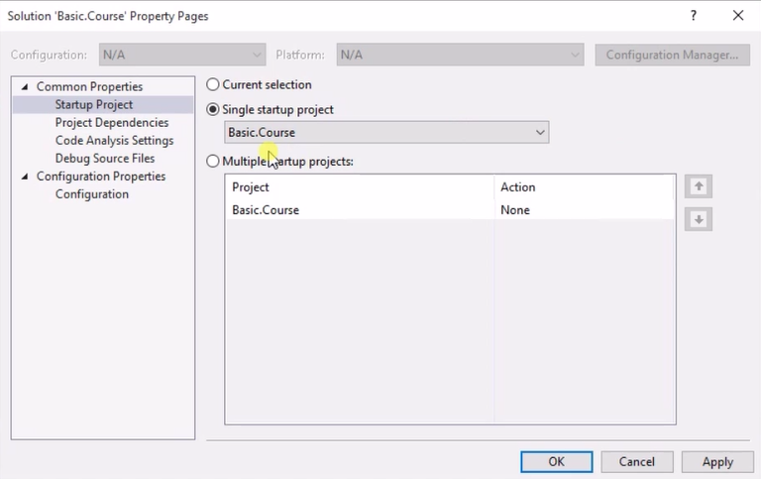
Opening The Solution Properties Page

Slide 32
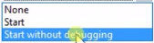
Setting The Startup Projects

Slide 33
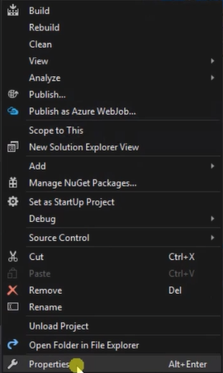
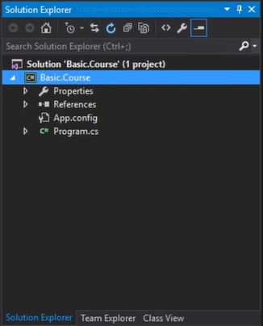
Opening the project properties page

Slide 34
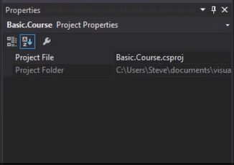
Opening the project properties page

Slide 35
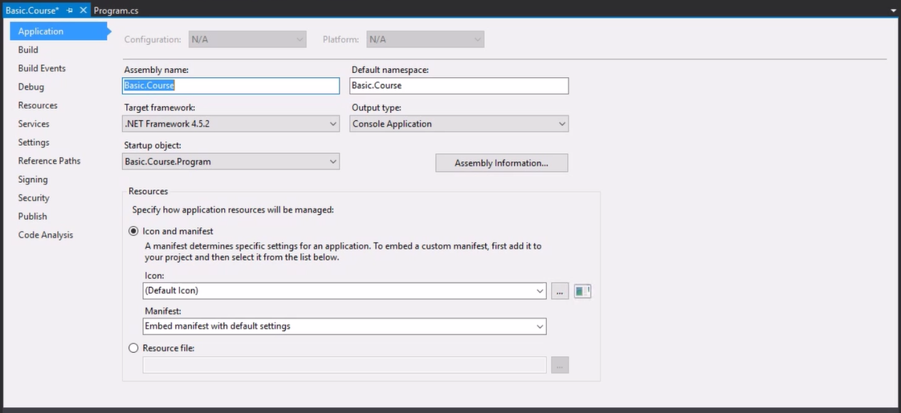
Opening the project properties page

Slide 36
Application Section

Slide 37
Assembly Name & Default Namespace

Slide 38
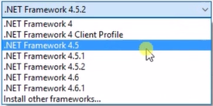
Target Framework

Slide 39
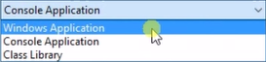
Output Type

Slide 40
Startup Object

Slide 41
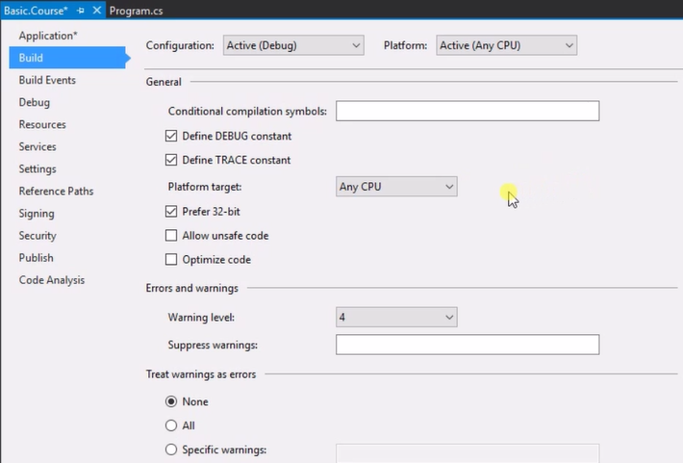
Build Section

Slide 42
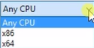
Platform Target

Slide 43
End Of Presentation

Slide 44
C# Basics
YouTube.com/ProgrammingMadeEZ
Techie-Tid-Bits.Blogspot.com
Hosted By: Steve Bishop

Slide 45
Solution and Project Properties
Demo

Slide 46
C# Basics
YouTube.com/ProgrammingMadeEZ
Techie-Tid-Bits.Blogspot.com
Hosted By: Steve Bishop

Slide 47
Basic Concepts Summary
Writing Your First Code
.NET Framework
CLR (Common Language Runtime)
Class Library
Scope and Statements
Variables
How To Create and Use Them
Numeric Data Types
Using Suffixes
Mathematical Operators
Basic Arithmetic
Increment and Decrement Operators
Array Variables
Debugging Code

Slide 48
End Of Presentation

Slide 49
C# Basics
YouTube.com/ProgrammingMadeEZ
Techie-Tid-Bits.Blogspot.com
Hosted By: Steve Bishop

Slide 50
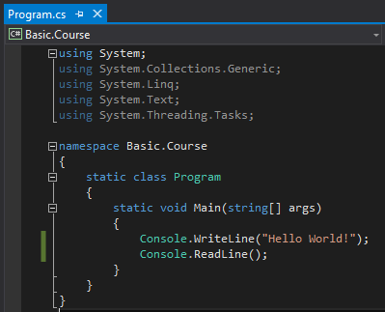
Writing Your First Code

Slide 51
C# Basics
YouTube.com/ProgrammingMadeEZ
Techie-Tid-Bits.Blogspot.com
Hosted By: Steve Bishop

Slide 52
.NET Framework
.NET Framework Description:
https://en.wikipedia.org/wiki/.NET_Framework
.NET Framework History:
https://en.wikipedia.org/wiki/.NET_Framework_version_history

Slide 53
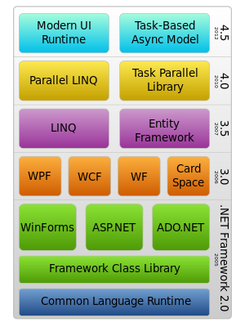

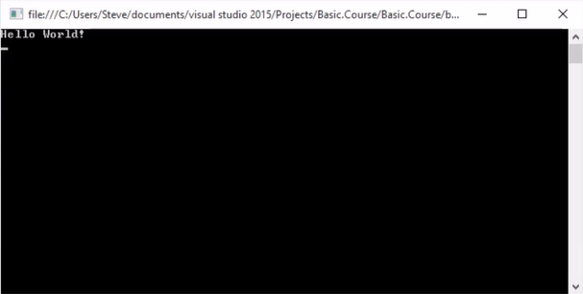
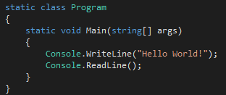
.Net Framework

Slide 54
.NET Framework
Hardware
Operating System
Common Language Runtime (CLR)
Common Intermediate Language
C#, F#, VB.NET Classes
Just In Time Compiler (Machine Code)
Class Library

Slide 55
End Of Presentation

Slide 56
C# Basics
YouTube.com/ProgrammingMadeEZ
Techie-Tid-Bits.Blogspot.com
Hosted By: Steve Bishop

Slide 57
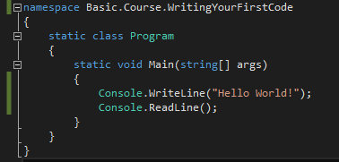
Scope and Statements
Scope:
Curly Braces
Namespace Scope
Class Scope
Method Scope

Slide 58
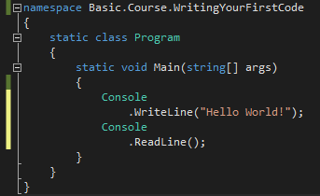
Scope and Statements
Statement:
Semi-Colon

Slide 59
End Of Presentation

Slide 60
C# Basics
YouTube.com/ProgrammingMadeEZ
Techie-Tid-Bits.Blogspot.com
Hosted By: Steve Bishop

Slide 61
Scope and statements
Demo

Slide 62
C# Basics
YouTube.com/ProgrammingMadeEZ
Techie-Tid-Bits.Blogspot.com
Hosted By: Steve Bishop

Slide 63
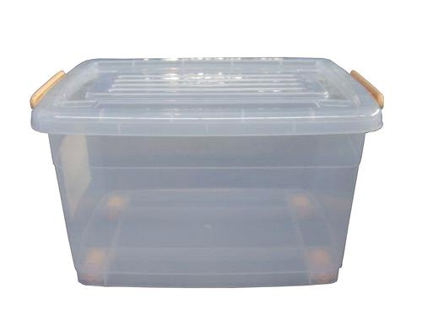
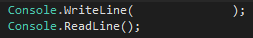
Variables
Storage containers for data in memory

Slide 64
Variables
Declaration First
Data Type
Variable Name
Assignment Operator
Value

Slide 65
Variables
Declaration With An Initial Value
Data Type
Variable Name
Value
Assignment Operator

Slide 66
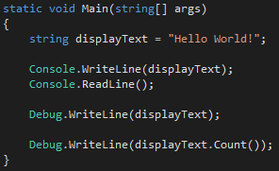
Variables
Declare Variable
“Hello World”
“Hello World”
“Hello World”
Extension Methods – Provide additional functionality

Slide 67
End Of Presentation

Slide 68
C# Basics
YouTube.com/ProgrammingMadeEZ
Techie-Tid-Bits.Blogspot.com
Hosted By: Steve Bishop

Slide 69
Variables
Demo

Slide 70
C# Basics
YouTube.com/ProgrammingMadeEZ
Techie-Tid-Bits.Blogspot.com
Hosted By: Steve Bishop

Slide 71
Numeric Types
Integral Numbers
Floating Point and Decimal Numbers
Boolean

Slide 72
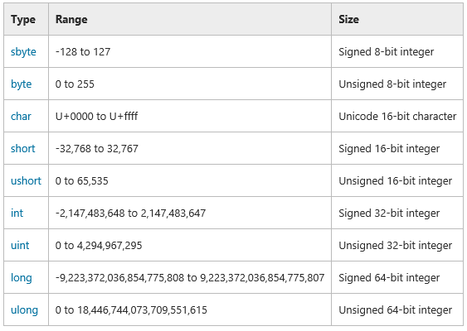
Integral Numbers

Slide 73
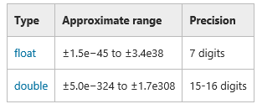
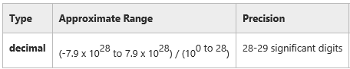
Floating Point and Decimal Numbers

Slide 74
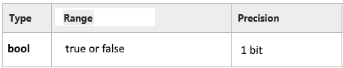
Boolean

Slide 75
End Of Presentation

Slide 76
C# Basics
YouTube.com/ProgrammingMadeEZ
Techie-Tid-Bits.Blogspot.com
Hosted By: Steve Bishop

Slide 77
Numeric Types
Demo

Slide 78
C# Basics
YouTube.com/ProgrammingMadeEZ
Techie-Tid-Bits.Blogspot.com
Hosted By: Steve Bishop

Slide 79
Using suffixes
What suffixes are
Why we need suffixes
How to use suffixes
List of suffixes

Slide 80
Using Suffixes
What are suffixes?
Suffixes define the type of literal if the literal is not a default type.
Why do we need suffixes?
Because the compiler uses default types when parsing literals.
How do we use suffixes?
Just like with literature, we put them at the end of a value.
Use capitalized letters for clarity.

Slide 81
Using Suffixes
List Of Suffixes
L: Long
D: Double
F: Float
M: Decimal
U: Unsigned Int
UL: Unsigned Long

Slide 82
End Of Presentation

Slide 83
C# Basics
YouTube.com/ProgrammingMadeEZ
Techie-Tid-Bits.Blogspot.com
Hosted By: Steve Bishop

Slide 84
Using Suffixes
Demo

Slide 85
C# Basics
YouTube.com/ProgrammingMadeEZ
Techie-Tid-Bits.Blogspot.com
Hosted By: Steve Bishop

Slide 86
Mathematical Operators Basic Arithmetic
+ : Add two values and return result
3+2 returns 5
- : Subtract 2nd value from the 1st value and return result
3-2 returns 1
* : Multiply two values and return result
3*2 returns 6
/ : Divide 2nd value from 1st value and return result rounded down
3/2 returns 1
Division by zero produces application error
Always rounds down (Use Math.Round() to round to nearest whole number)
% : Divide 2nd value from 1st value and return remainder
3%2 returns 1
Variables must be of same type unless they can be converted implicitly. (int + int, double – double, etc…)

Slide 87
End Of Presentation

Slide 88
C# Basics
YouTube.com/ProgrammingMadeEZ
Techie-Tid-Bits.Blogspot.com
Hosted By: Steve Bishop

Slide 89
Mathematical Operators Basic Arithmetic
Demo

Slide 90
C# Basics
YouTube.com/ProgrammingMadeEZ
Techie-Tid-Bits.Blogspot.com
Hosted By: Steve Bishop

Slide 91
Mathematical Operators Incremental & Decremental
++ : Increment Operator - Increases value by 1
If used before the operand it returns the value after the increase
int a = 5; ++a returns 6.
If used after the operand it returns the value before the increase
int a = 5; a++ returns 5.
Both a++ and ++a return 6 on the line after the increase
-- : Decrement Operator - Decreases value by 1
If used before the operand it returns the value after the decrease
int a = 5; --a returns 4.
If used after the operand it returns the value before the decrease
int a = 5; a– returns 5.
Both a-- and --a return 4 on the line after the decrease

Slide 92
End Of Presentation

Slide 93
C# Basics
YouTube.com/ProgrammingMadeEZ
Techie-Tid-Bits.Blogspot.com
Hosted By: Steve Bishop

Slide 94
Mathematical Operators incremental & Decremental
Demo

Slide 95
C# Basics
YouTube.com/ProgrammingMadeEZ
Techie-Tid-Bits.Blogspot.com
Hosted By: Steve Bishop

Slide 96
Using Strings
Concatenation
Combine two strings together with the + symbol
Example:
string greeting = “Hello, my name is: “ + “John”;
Converting Numeric Data Types to Strings
Use the .ToString() extension method to convert a numeric variable to a string
Example:
double pi = 3.14159265;
string output = “Tom says the value of pi is “ + pi.ToString();

Slide 97
Using Strings
Escape Sequences
Use the \ character to indicate a special Unicode escape sequence
\r – Carriage Return
\n – New Line
\t – Tab
\’ – Apostrophe
\” – Quotation Mark
\\ - One Backslash
Example:
string twoSentences = "\"I saw a man\" Charlie said,\r\n\"He was running East on Main Street.\"";
Results in:
“I saw a man” Charlie said,
“He was running East on Main Street.”

Slide 98
End Of Presentation

Slide 99
C# Basics
YouTube.com/ProgrammingMadeEZ
Techie-Tid-Bits.Blogspot.com
Hosted By: Steve Bishop

Slide 100
Using Strings
Demo

Slide 101
C# Basics
YouTube.com/ProgrammingMadeEZ
Techie-Tid-Bits.Blogspot.com
Hosted By: Steve Bishop

Slide 102
Array Variables
Array variables allow you to store multiple values of the same data type in one variable.
Uses Index or Subscript to reference a specific value within the array
Declared separately or with initial values
Declared with or without initial Index/Subscript ranges
Value retrieval begins at Index/Subscript 0

Slide 103
Array Variables
Process of Declaring an Array Variable
Declaration of Variable as an Array
Assign new Array to variable with Subscript Range
Assign a value to the Subscript value

Slide 104
Array Variables
Declaring Array With Initial Value
Initial Values
0, 1, 2 - Subscript
Array Declaration
Subscript
Range

Slide 105
Array Variables
Reference a Location Within an Array
Assign a value
Retrieve a value

Slide 106
End Of Presentation

Slide 107
C# Basics
YouTube.com/ProgrammingMadeEZ
Techie-Tid-Bits.Blogspot.com
Hosted By: Steve Bishop

Slide 108
Array Variables
Demo

Slide 109
C# Basics
YouTube.com/ProgrammingMadeEZ
Techie-Tid-Bits.Blogspot.com
Hosted By: Steve Bishop

Slide 110
Explicit Conversions
Convert the data of a variable to another data type.
Syntax:
int x = 8;
double y = 9.05;
double sum = y + (double)x;

Slide 111
End Of Presentation

Slide 112
C# Basics
YouTube.com/ProgrammingMadeEZ
Techie-Tid-Bits.Blogspot.com
Hosted By: Steve Bishop

Slide 113
Debugging Your Code
Three types of coding bugs
Compile Time Error
An error in the way the code is written that violates the C# syntax
Easiest to locate
Visual Studio red squiggly line (missing ; or ()’s)
Run Time Error
An error in the way the application runs. Usually a bad assignment or calculation.
Only found when application is ran or with Unit Testing
Popup error message box during run-time (Divide by Zero, Index out of Range)
Logical Error
Code is syntactically correct and does not break, but results are unexpected
Most difficult to avoid and locate, but can be avoided with proper Unit Testing
There are no warning messages just bad results

Slide 114
Debugging Code
Understand the error and it’s related message
Identify the location of an error
Use Break Points to stop code before it is executed
Step through the code line by line to watch the results of the code for each step
Watch variable values to determine if there is a problem with an assignment
Determine if an earlier break point is needed to find the source of the problem
Comment out bad code and fix errors
See if the code can be stepped through without an error
Run the application again to verify the error is fixed

Slide 115
End Of Presentation

Slide 116
C# Basics
YouTube.com/ProgrammingMadeEZ
Techie-Tid-Bits.Blogspot.com
Hosted By: Steve Bishop

Slide 117
Debugging Code
Demo

Slide 118
C# Basics
YouTube.com/ProgrammingMadeEZ
Techie-Tid-Bits.Blogspot.com
Hosted By: Steve Bishop

Slide 119
Control Flow
Make decisions about which pieces of code should be ran.
Relational Operators
Logical Operators
If-Else Statements
ElseIf Statements
Switch-Case Statements
While Loop
Do While Loop
For Loop
For Each Loop
Jumping

Slide 120
End Of Presentation

Slide 121
C# Basics
YouTube.com/ProgrammingMadeEZ
Techie-Tid-Bits.Blogspot.com
Hosted By: Steve Bishop

Slide 122
Relational Operators
Operators that result in a true or false (Boolean) result.
== : Equals
Returns True if two values are equal to each other (5 == 5)
Returns False if the two values are not equal to each other (5 == 6)
!= : Not Equals
Returns True if two values are not equal to each other (5 != 4)
Returns False if the two values are equal to each other (5 != 5)
> : Greater Than
Returns True if the first value is greater than the second value (5 > 4)
Returns False if the first value is less than or equal to the second value (5 > 6) (5 > 5)
< : Less Than
Returns True if the first value is less than the second value (5 < 6)
Returns False if the first value is greater than or equal to the second value (5 < 4) (5 < 5)
>= : Greater Than or Equal To
Returns True if the first value is greater than or equal to the second value (5 >= 4) (5 >= 5)
Returns False if the first value is less than the second value (5 >= 6)
<= Less Than or Equal To
Returns True if the first value is less than or equal to the second value (5 <= 6) (5 <= 5)
Returns False if the first value is greater than the second value (5 <= 4)

Slide 123
End Of Presentation

Slide 124
C# Basics
YouTube.com/ProgrammingMadeEZ
Techie-Tid-Bits.Blogspot.com
Hosted By: Steve Bishop

Slide 125
Relational Operators
Demo

Slide 126
C# Basics
YouTube.com/ProgrammingMadeEZ
Techie-Tid-Bits.Blogspot.com
Hosted By: Steve Bishop

Slide 127
Logical Operators
Allow you to check if multiple conditions are true
Used in conjunction with relational operators
Use parenthesis to group conditions
Can chain multiple conditions

Slide 128
Logical Operators
&& Operator
Also known as the AND operator
Returns True if both first and second condition are True
Use:
(5 == 5 && 6 != 7) - returns True
(5 == 5 && 6 == 7) - returns False
|| Operator
Also known as the OR operator
Returns True if either the first or second condition is True
Use:
(5 == 5 || 6 == 7) - returns True
(5 == 6 || 6 != 7) – returns True
(5 == 6 || 6 == 7) – returns False

Slide 129
Logical Operators
Chaining Operators
int x = 5;
bool result = ((x < 6 && x > 1) || x == 20 || (x != 13 && x >=0))
Answer: true
bool result2 = ((x !=5 && x > 8) || (x == 5 && x >7))
Answer: false

Slide 130
End Of Presentation

Slide 131
C# Basics
YouTube.com/ProgrammingMadeEZ
Techie-Tid-Bits.Blogspot.com
Hosted By: Steve Bishop

Slide 132
Logical Operators
Demo

Slide 133
C# Basics
YouTube.com/ProgrammingMadeEZ
Techie-Tid-Bits.Blogspot.com
Hosted By: Steve Bishop

Slide 134
If-Else Statement
Logical statement to determine a set of commands to perform
Uses Boolean value to make the decision
Commands within “if” scope are performed in the Boolean value is true
Commands within “else” scope are performed if the Boolean value is false

Slide 135
If-Else Statement
Syntax:
if (true)
{
//Statement To Perform if true;
}
else
{
//Statement To Perform if false;
}

Slide 136
End Of Presentation

Slide 137
C# Basics
YouTube.com/ProgrammingMadeEZ
Techie-Tid-Bits.Blogspot.com
Hosted By: Steve Bishop

Slide 138
If-Else Statement
Demo

Slide 139
C# Basics
YouTube.com/ProgrammingMadeEZ
Techie-Tid-Bits.Blogspot.com
Hosted By: Steve Bishop

Slide 140
Else If
Adds alternative conditions to check for with an if statement
Syntax:
if (condition1 == true)
{
//Statement to perform if condition1 is true;
}
else if (condition2 == true)
{
//Statement to perform if condition2 is true;
}
else
{
//Statement To Perform if both condition1 and condition2 are false;
}

Slide 141
End Of Presentation

Slide 142
C# Basics
YouTube.com/ProgrammingMadeEZ
Techie-Tid-Bits.Blogspot.com
Hosted By: Steve Bishop

Slide 143
Else If Statement
Demo

Slide 144
C# Basics
YouTube.com/ProgrammingMadeEZ
Techie-Tid-Bits.Blogspot.com
Hosted By: Steve Bishop

Slide 145
Switch-Case Statements
Compares a primary value against a set of candidate equivalent constants
Simplifies the If/Else-If/Else statement (but not as versatile)
Does not use relational operators
Only checks for an equal constant
“Break” keyword must be used at the end of commands to be executed
Default section is executed if no equivalent constants are found

Slide 146
Switch-Case Statements
Syntax:
switch(value)
{
case constant1:
//Commands to perform
break;
case constant2:
case constant3:
//Commands to perform
break;
default:
//Commands to perform
break;
}

Slide 147
End Of Presentation

Slide 148
C# Basics
YouTube.com/ProgrammingMadeEZ
Techie-Tid-Bits.Blogspot.com
Hosted By: Steve Bishop

Slide 149
Switch-Case Statements
Demo

Slide 150
C# Basics
YouTube.com/ProgrammingMadeEZ
Techie-Tid-Bits.Blogspot.com
Hosted By: Steve Bishop

Slide 151
While Loop
While loops execute code within it’s scope until a specified expression is false
Uses Boolean expressions (typically the result of Relational Operators) to determine if the code should be executed
Typically use increment or decrement operators to modify a value within the expression until the expression is evaluated to false
Useful for executing code repeatedly until you need it to stop
Be careful of infinite loops

Slide 152
While Loop
Syntax:
int x = 0;
while (x < 10)
{
//Commands to execute
x++;
}

Slide 153
While Loop
Alternate Syntax:
bool performCode = true;
int x = 0;
while (performCode)
{
//Commands to execute
performCode = (++x < 10);
}

Slide 154
End Of Presentation

Slide 155
C# Basics
YouTube.com/ProgrammingMadeEZ
Techie-Tid-Bits.Blogspot.com
Hosted By: Steve Bishop

Slide 156
While Loop
Demo

Slide 157
C# Basics
YouTube.com/ProgrammingMadeEZ
Techie-Tid-Bits.Blogspot.com
Hosted By: Steve Bishop

Slide 158
Do While Loop
Do-While loops repeats the execution of code within it’s scope until a specified expression is false
Uses Boolean expressions (typically the result of Relational Operators) to determine if the code should be repeated
While expression is evaluated after code within the do scope is performed
Code within “do” scope performed at least one time
Typically use increment or decrement operators to modify a value within the expression until the expression is evaluated to false
Useful for executing code repeatedly until you need it to stop
Be careful of infinite loops

Slide 159
Do While Loop
Syntax:
int x = 0;
do
{
//Commands to execute
x++;
} while (x < 10)
True
False

Slide 160
End Of Presentation

Slide 161
C# Basics
YouTube.com/ProgrammingMadeEZ
Techie-Tid-Bits.Blogspot.com
Hosted By: Steve Bishop

Slide 162
Do While Loop
Demo

Slide 163
C# Basics
YouTube.com/ProgrammingMadeEZ
Techie-Tid-Bits.Blogspot.com
Hosted By: Steve Bishop

Slide 164
For Loop
For loops repeat the execution of code within it’s scope while a specified expression is true
Uses Boolean expressions (typically the result of Relational Operators) to determine if the code should be executed
Evaluated variable and Increment or Decrement operator are declared within the expression
Useful for executing code repeatedly until you need it to stop
Limits the possibility of infinite loops (but still possible)
More compact but identical to the logic of a while loop

Slide 165
For Loop
Syntax:
for (int x = 1; x < 5; x++)
{
//Commands to execute
}

Slide 166
End Of Presentation

Slide 167
C# Basics
YouTube.com/ProgrammingMadeEZ
Techie-Tid-Bits.Blogspot.com
Hosted By: Steve Bishop

Slide 168
For Loop
Demo

Slide 169
C# Basics
YouTube.com/ProgrammingMadeEZ
Techie-Tid-Bits.Blogspot.com
Hosted By: Steve Bishop

Slide 170
Foreach Loop
Loops through items within a collection or array
A variable is used to reference the item currently inspected by the loop
Performs the commands within the ForEach scope once for each item
Do not add or remove items to the collection as part of the commands

Slide 171
ForEach Loop
Syntax:
int[] fibonacci = new int[8] { 0, 1, 1, 2, 3, 5, 8, 13 };
foreach(int number in fibonacci)
{
Console.WriteLine(number);
}

Slide 172
End Of Presentation

Slide 173
C# Basics
YouTube.com/ProgrammingMadeEZ
Techie-Tid-Bits.Blogspot.com
Hosted By: Steve Bishop

Slide 174
ForEach Loop
Demo

Slide 175
C# Basics
YouTube.com/ProgrammingMadeEZ
Techie-Tid-Bits.Blogspot.com
Hosted By: Steve Bishop

Slide 176
Jumping Statements
Allow us a way to move to different sections of our code
Have no conditions that need to be met in order to jump
Give us a way to exit or skip sections of the code when needed
Mostly used within looping statements like While, Do-While, For, and Foreach

Slide 177
Jumping Statements
Keywords:
Break – Exit the current scope
Continue – Go back to the start of the looping statement
Goto – Skip to a labled section of code
Return – Exit the method or property scope
Throw – Halt the execution of code and return an error

Slide 178
End Of Presentation

Slide 179
C# Basics
YouTube.com/ProgrammingMadeEZ
Techie-Tid-Bits.Blogspot.com
Hosted By: Steve Bishop

Slide 180
Jumping Statements
Demo

Slide 181
C# Basics
YouTube.com/ProgrammingMadeEZ
Techie-Tid-Bits.Blogspot.com
Hosted By: Steve Bishop

Slide 182
Try Catch Blocks
Performs a block of code and if an error occurs other actions can be performed.
Syntax:
try {
int x = 0;
int y = 7 / x;
}
catch (exception ex) {
Console.Writeline(“Error: “ + ex.message);
}
Division By Zero Exception

Slide 183
End Of Presentation

Slide 184
C# Basics
YouTube.com/ProgrammingMadeEZ
Techie-Tid-Bits.Blogspot.com
Hosted By: Steve Bishop

Slide 185
Classes
What classes are
How to create classes
How to create methods and properties
What parameters are
How to use classes in our code
Shortcuts to writing code
Method overloading is
Class Constructors
Reference types vs. value types

Slide 186
End Of Presentation

Slide 187
C# Basics
YouTube.com/ProgrammingMadeEZ
Techie-Tid-Bits.Blogspot.com
Hosted By: Steve Bishop

Slide 188
Classes
Custom Types that allow us to group behavior and data
Members: Self contained groups of code that represent either a behavior or data
Properties: Allows you to read, write, or compute a data value privately held within the class
Methods (functions): An action which either alters data or presents data

Slide 189
Classes
A simpler way to think of classes:
Class: Blueprint to make a THING
Property: A adjective describing that thing
Method: A verb describing how that thing behaves

Slide 190





Classes
class GingerbreadMan

Slide 191
Classes
GingerbreadMan Members
Properties
Methods
class GingerbreadMan
string Ingredients[]
MixIngredients
string Color
AddFrosting
string Frosting
CutOut
bool
Cooked
Bake
int
Temperature
IsCooked

Slide 192
End Of Presentation

Slide 193
C# Basics
YouTube.com/ProgrammingMadeEZ
Techie-Tid-Bits.Blogspot.com
Hosted By: Steve Bishop

Slide 194
Methods
Encapsulate code into a single group which can alter, present data, or both.
Declaring a Method
Parameters of a Method
Returning Values From a Method
Calling a Method
Scope of Functions
Access Modifiers

Slide 195
C# Basics
YouTube.com/ProgrammingMadeEZ
Techie-Tid-Bits.Blogspot.com
Hosted By: Steve Bishop

Slide 196
Declaring A Method
Parts of the declarative statement
Access Modifier
Return Type
Method Name
Parameters
Scope

Slide 197
Declaring A Method
Syntax:
private
int
addTwoIntegers
(int value1, int value2)
{
}
Scope
//Commands To Execute
Access Modifier
Data Type
Method Name
Parameters

Slide 198
End Of Presentation

Slide 199
C# Basics
YouTube.com/ProgrammingMadeEZ
Techie-Tid-Bits.Blogspot.com
Hosted By: Steve Bishop

Slide 200
Declaring A Method
Demo

Slide 201
C# Basics
YouTube.com/ProgrammingMadeEZ
Techie-Tid-Bits.Blogspot.com
Hosted By: Steve Bishop

Slide 202
Declaring An Object
Declare a variable with the data type of the class you want to use
Assign the variable a value using the “new” keyword along with the class name
Use parenthesis at the end of the new class declaration
Example:
MyClass MyObject = new MyClass();

Slide 203
End Of Presentation

Slide 204
C# Basics
YouTube.com/ProgrammingMadeEZ
Techie-Tid-Bits.Blogspot.com
Hosted By: Steve Bishop

Slide 205
Parameters
Parameters are variables which hold values passed into the method by the caller
Act just like variables with pre-assigned values in the method scope
Must have a data type
Must have a name
Declared as optional by assigning a default value, otherwise they are required

Slide 206
End Of Presentation

Slide 207
C# Basics
YouTube.com/ProgrammingMadeEZ
Techie-Tid-Bits.Blogspot.com
Hosted By: Steve Bishop

Slide 208
Declaring A Property
Properties have a Get and Set accessor which are both optional
Get: Returns the value
Set: Sets the value
For every property there is an underlying private variable in the class which the Get and Set accessors control access to
Values passed into the Set accessor are assigned to the default parameter called “value”

Slide 209
Declaring A Property
Syntax:
class MyClass {
private int _myProperty;
public int MyProperty {
get { return _myProperty; }
set { _myProperty = value; }
}
}

Slide 210
End Of Presentation

Slide 211
C# Basics
YouTube.com/ProgrammingMadeEZ
Techie-Tid-Bits.Blogspot.com
Hosted By: Steve Bishop

Slide 212
Using An Object
Declare your object variable and assign it a new instance of the class
Assign values to the object properties
Call object methods and view the results

Slide 213
End Of Presentation

Slide 214
C# Basics
YouTube.com/ProgrammingMadeEZ
Techie-Tid-Bits.Blogspot.com
Hosted By: Steve Bishop

Slide 215
Property Shortcuts
Make a class variable Public
Using automatically implemented property declarations
Using the “prop” code snippet

Slide 216
End Of Presentation

Slide 217
C# Basics
YouTube.com/ProgrammingMadeEZ
Techie-Tid-Bits.Blogspot.com
Hosted By: Steve Bishop

Slide 218
Method Overloading And Signatures
Method Signatures:
The declarative statement of the method
Example:
private int addTwoIntegers(int value1, int value2)
Method Overloading:
Creating two or more methods of the same name but with different signatures.
Example:
private int addTwoNumbers(int value1, int value2)
private double addTwoNumbers(double value1, double value2)
private int addTwoNumbers(int value1, int value2, int maxTotal)

Slide 219
End Of Presentation

Slide 220
C# Basics
YouTube.com/ProgrammingMadeEZ
Techie-Tid-Bits.Blogspot.com
Hosted By: Steve Bishop

Slide 221
Class Constructors
Class Constructor:
Method which is ran when a class is instantiated
Parameters can be passed into the constructor
Code Snippet Shortcut: ctor
Syntax:
class MyClass {
public MyClass {
//Code to perform
}
}

Slide 222
End Of Presentation

Slide 223
C# Basics
YouTube.com/ProgrammingMadeEZ
Techie-Tid-Bits.Blogspot.com
Hosted By: Steve Bishop

Slide 224
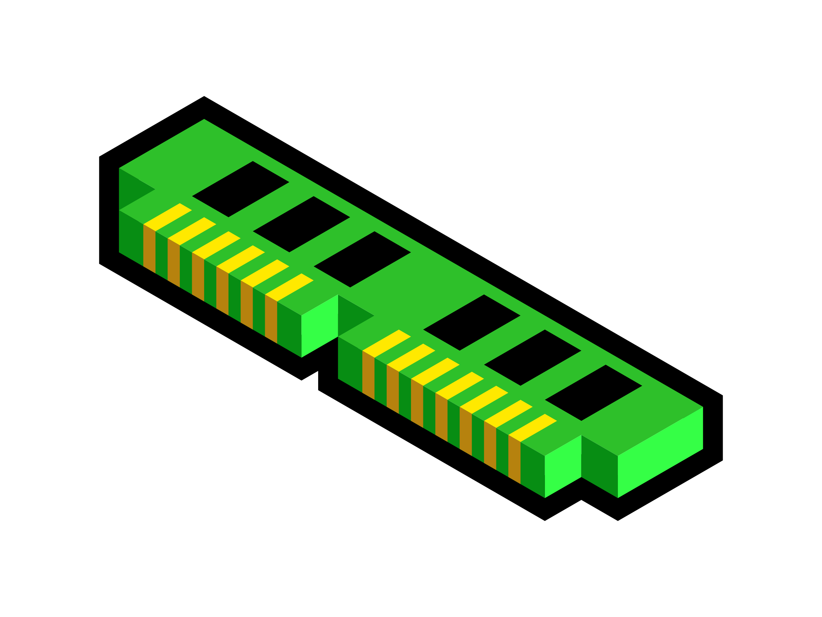
Classes and Reference Types
Reference Types
Data types which hold a reference to a location in memory rather than the data itself
MyObject
(memory address)
MyClass
Value1
Value2
doMath
MyObject2
(memory address)
=

Slide 225
End Of Presentation

Slide 226
C# Basics
YouTube.com/ProgrammingMadeEZ
Techie-Tid-Bits.Blogspot.com
Hosted By: Steve Bishop

Slide 227
Object Oriented Programming
A programing methodology that uses objects as the foundational concept.
We use OOP to better organize our code and manage relationships between the different pieces of code. Object Oriented Programming allows us to be more efficient with designing complex concepts, more organized in the code maintenance and changes, and makes the code versatile so that components of our code can be used in multiple places.

Slide 228

3 (or 4) Pillars of OOP
Object Oriented Programming
Encapsulation
Inheritance
Polymorphism
Abstraction

Slide 229
3 (or 4) Pillars of OOP
Encapsulation
Binding together pieces of code and keep it obscure to prevent outside changes.
Inheritance
Basing one type (or class) on another type allowing us to re-use pre-written code.
Polymorphism
Present the same type (or class) but the definitions of members perform differently
Abstraction
Penultimate use of all 3 pillars. Offers an indirect usage of encapsulated code, provides an class to inherit from, and provides no specific action or data, just defines the members

Slide 230
End Of Presentation

Slide 231
C# Basics
YouTube.com/ProgrammingMadeEZ
Techie-Tid-Bits.Blogspot.com
Hosted By: Steve Bishop

Slide 232

Encapsulation
Binding together pieces of code and keep it obscure to prevent outside changes.
MyClass
MyObject
Value1
Value1
Value2
Value2
X
AddTwoIntigers
AddTwoIntigers
doMath
doMath

Slide 233
End Of Presentation

Slide 234
C# Basics
YouTube.com/ProgrammingMadeEZ
Techie-Tid-Bits.Blogspot.com
Hosted By: Steve Bishop

Slide 235
Inheritance
Basing one type (or class) on another type allowing us to re-use pre-written code.
MyClass
MyOtherClass
Is A type of
Total
Constructor
addTwoIntigers

Slide 236
End Of Presentation

Slide 237
C# Basics
YouTube.com/ProgrammingMadeEZ
Techie-Tid-Bits.Blogspot.com
Hosted By: Steve Bishop

Slide 238
Polymorphism
Present the same type (or class) but the definitions of members perform differently
MyOtherClass
MyClass
Total
Total
Constructor
Constructor(value1, value2, maxTotal)
addTwoIntigers
(value1 + value2) =< maxTotal

Slide 239
End Of Presentation

Slide 240
C# Basics
YouTube.com/ProgrammingMadeEZ
Techie-Tid-Bits.Blogspot.com
Hosted By: Steve Bishop

Slide 241
Abstraction
A definition of the members a derived class should contain.
AdditonClass Definition
Properties
Methods
Total
AddTwoValues
AddIntegersClass
AddDoublesClass
= MyAdditionObject =
Total
AddTwoValues
Total
AddTwoValues

Slide 242
End Of Presentation

Slide 243
C# Basics
YouTube.com/ProgrammingMadeEZ
Techie-Tid-Bits.Blogspot.com
Hosted By: Steve Bishop

Slide 244
Interfaces
A special type of abstract class that allows for multiple inheritance
Value2
Value1
Value2
Value1
Value2
Properties:
Value1
Sum
Product
Difference
Quotient
Methods:
Sum
Product
Difference
Quotient
ValueIncrease Class
ValueDecrease Class

Slide 245
End Of Presentation

Slide 246
C# Basics
YouTube.com/ProgrammingMadeEZ
Techie-Tid-Bits.Blogspot.com
Hosted By: Steve Bishop

Slide 247
Odds & Ends
Generics
Collections
Multiple Projects and References
NuGet

Slide 248
End Of Presentation

Slide 249
C# Basics
YouTube.com/ProgrammingMadeEZ
Techie-Tid-Bits.Blogspot.com
Hosted By: Steve Bishop

Slide 250
Generics
Delays the type specification until the class or method is called.
Data types are passed to a class or method as a “type parameter”
The class or method define the type parameter with <T> at the end of the name of the class or method
Type parameters are passed into the class or method within <> at the end of the name of the class or method
Defining a type parameter as part of the class signature defines that parameter for the entire class
Defining a type parameter as part of a method defines that parameter for only that method

Slide 251
Generics
Class Type Parameter Syntax:
class MyClass<T> {
public T Result { get; set; }
public MyClass(T value1) {
//Code to execute on class instantiation
}
public T ReturnsObject(T value1) {
return value1;
}
}

Slide 252
Generics
Method Type Parameter Syntax:
class MyClass {
public T ReturnsObject<T>(T value1) {
return value1;
}
}

Slide 253
End Of Presentation

Slide 254
C# Basics
YouTube.com/ProgrammingMadeEZ
Techie-Tid-Bits.Blogspot.com
Hosted By: Steve Bishop

Slide 255
Collections
Most popular types of collections
Array
List
Collection
Collections that inherit from IEnumerable interface permit iteration over the items making them the most common collection types
Enumerable collections are most commonly implemented for their ease of use in ForEach loops

Slide 256
Collections
Defining an IEnumerable collection
IEnumerable<type> MyItems = new List<type>();
Using an IEnumerable collection
foreach (type item in MyItems) {
//Code to perform on item variable
}

Slide 257
End Of Presentation

Slide 258
C# Basics
YouTube.com/ProgrammingMadeEZ
Techie-Tid-Bits.Blogspot.com
Hosted By: Steve Bishop

Slide 259
Adding Projects and References
Demo

Slide 260
C# Basics
YouTube.com/ProgrammingMadeEZ
Techie-Tid-Bits.Blogspot.com
Hosted By: Steve Bishop

Slide 261
Nuget Packages
Demo

